Slide 1
RDz Workbench – BMS and MFS Map Editors
Jon Sayles, Rational System z Products - jsayles@us.ibm.com
Notes:
Developing COBOL with IBM WebSphere Developer for zSeries
Module 10 - CICS BMS maps

Slide 2
IBM Trademarks and Copyrights
© Copyright IBM Corporation 2007,2008, 2009, 2010, 2011. All rights reserved.
The information contained in these materials is provided for informational purposes only, and is provided AS IS without warranty of any kind, express or implied. IBM shall not be responsible for any damages arising out of the use of, or otherwise related to, these materials. Nothing contained in these materials is intended to, nor shall have the effect of, creating any warranties or representations from IBM or its suppliers or licensors, or altering the terms and conditions of the applicable license agreement governing the use of IBM software. References in these materials to IBM products, programs, or services do not imply that they will be available in all countries in which IBM operates.
This information is based on current IBM product plans and strategy, which are subject to change by IBM without notice. Product release dates and/or capabilities referenced in these materials may change at any time at IBM’s sole discretion based on market opportunities or other factors, and are not intended to be a commitment to future product or feature availability in any way.
IBM, the IBM logo, the on-demand business logo, Rational, the Rational logo, and other IBM Rational products and services are trademarks or registered trademarks of the International Business Machines Corporation, in the United States, other countries or both. Other company, product, or service names may be trademarks or service marks of others.
Notes:
Developing COBOL with IBM WebSphere Developer for zSeries
Module 10 - CICS BMS maps

Slide 3

Course Contributing Authors
Thanks to the following individuals, for assisting with this course:
  David Bean/IBM
  Russ Courtney/IBM
  Gayatri Renganathan/IBM
Notes:
Developing COBOL with IBM WebSphere Developer for zSeries
Module 10 - CICS BMS maps

Slide 4
Course Overview
Audience
  This course is designed for application developers who have learned or programmed in COBOL, and who need to do z/OS Traditional Development and Maintenance as well as build leading-edge applications using COBOL and Rational Developer for System z.
Prerequisites
  This course assumes that the student has a basic understanding and knowledge of software computing technologies, and general data processing terms, concepts and vocabulary, as well as a working knowledge of COBOL and z/OS.
  Knowledge of SQL (Structured Query Language) is assumed for database access is assumed as well.
  Basic PC and mouse-driven development skills, terms and concepts are also assumed
Notes:
Developing COBOL with IBM WebSphere Developer for zSeries
Module 10 - CICS BMS maps

Slide 5
Note to IMS TM and MFS Developers
Appendix A contains material on using the RDz's graphical MFS editing tools
They are almost exactly the same as the BMS tools
Because of this, the recommendation is that you read through the content in the RDz/BMS Map Editor section
And then proceed to the Appendix on MFS

Slide 6
Course Topics
Course Name: Rational Developer for System z Foundation Training
Course Description: Learn how to use Rational Developer for System z to do z/OS traditional development, maintenance, support and for Enterprise Modernization of z/OS applications
Pre-requisites: Some experience developing COBOL applications using z/OS is expected. A working knowledge of SQL is also recommended.
Course Length: ~5days – or if done in self-paced mode, at your own pace
Topics (Agenda)
    Getting Started - installing and configuring RDz - and the course materials, and using Eclipse
    The RDz Workbench
      Code analysis tools
      Editing
      Compiling programs
      Debugging local COBOL programs
    The Data Perspective:
      Working with relational data sources
      Modifying test data
      Editing and testing SQL statements
    Working with remote system resources:
      Connecting to a mainframe
      Dataset management
      Accessing and editing files
    z/OS Application Development
      Creating MVS Subprojects
      Creating and customizing project properties
    Debugging z/OS Applications
      Debugging Batch Applications
      Setting Debug Tool for Online Applications
    Working with File Manager
      Creating test data
      Editing complex file-types
    Working with mainframe ABENDs using Fault Analyzer
      Creating Fault History views
      Analyzing and solving mainframe ABENDs
    Creating and modifying BMS Maps using the BMS Map Editor
Notes:
Developing COBOL with IBM WebSphere Developer for zSeries
Module 10 - CICS BMS maps

Slide 7
The RDz Workbench
UNIT
Topics:
BMS Terms and Concepts
RDz/BMS Map Editor
Appendix

Slide 8
Objectives
After completing this unit, you should be able to:
  Describe the types of 3270 data streams available to CICS applications
  Define the three BMS macros
  Define an "attribute byte"
  Describe how to code BMS macros (manually)
  List a few of the BMS field macro attributes
Notes:
Developing COBOL with IBM WebSphere Developer for zSeries
Module 10 - CICS BMS maps
http://publib.boulder.ibm.com/infocenter/cicsts/v3r1/index.jsp?topic=/com.ibm.cics.ts31.doc/dfhp3/dfhp3bj.htm

Slide 9
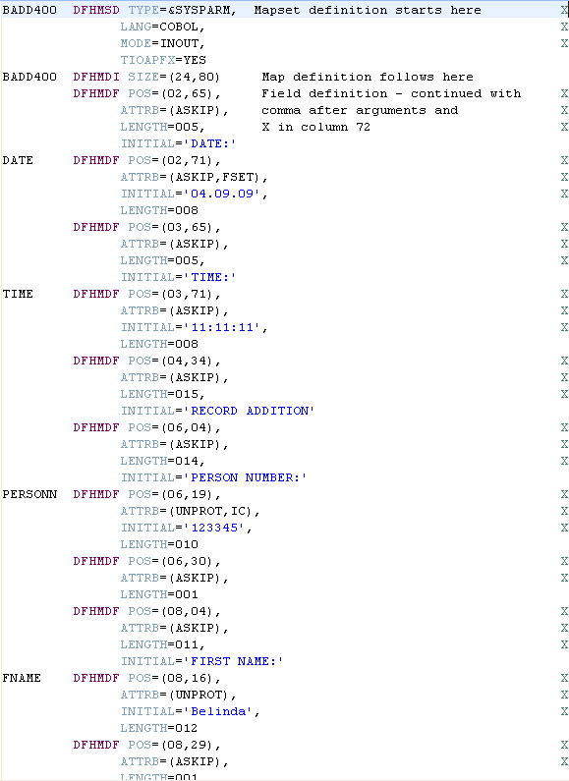

Brief Mini-Tutorial on BMS
Before jumping into RDz's BMS Map Editing features, if you're not familiar with the BMS macro language it might be a good use of 10-15 minutes of your time to read the slides in this mini-tutorial on BMS terms and concepts and vocabulary
Don't be a fake BMS developer… read on!
Notes:
Developing COBOL with IBM WebSphere Developer for zSeries
Module 10 - CICS BMS maps

Slide 10
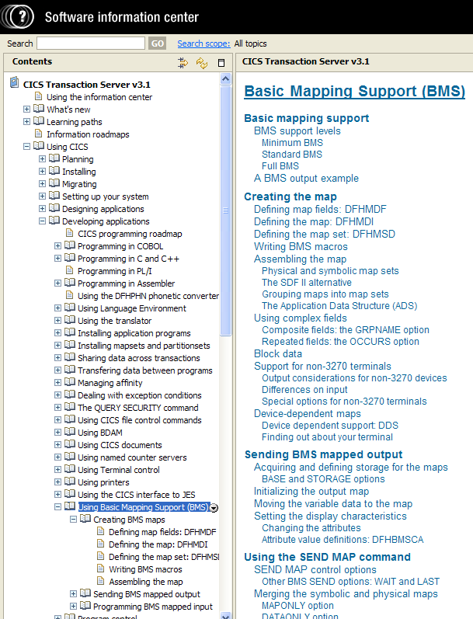
"Real" BMS Developers
 - Caveat
It must be noted that, while this section will assist you with the terms and concepts pre-requisite to using RDz's BMS Map Editor, if you are truly aspiring towards becoming a BMS-guru, you will need either:
A legitimate class in BMS per se'
  http://www-949.ibm.com/software/rational/cafe/docs/DOC-2895
…or…
⬅ You will have to do a lot more reading of books, or sources like this:
  http://publib.boulder.ibm.com/infocenter/cicsts/v3r1/index.jsp?topic=/com.ibm.cics.ts31.doc/dfhp3/dfhp3bj.htm
Notes:
Developing COBOL with IBM WebSphere Developer for zSeries
Module 10 - CICS BMS maps

Slide 11
What is BMS?
There are two ways for your program to communicate to a 3270-type terminal:
  1. Terminal Control – device-dependent data stream
  2. Basic Mapping Support (BMS) – macro-based device-
  independent service
CICS
Of the two, BMS is the predominant 3270/CICS technology
Your
Application
Program
Terminal Control
Data Stream

Green Screen
3270 Terminal
Basic Mapping Support
Macros
Notes:
Developing COBOL with IBM WebSphere Developer for zSeries
Module 10 - CICS BMS maps
The CICS application programming interface contains two sets of commands for communicating with terminals:
1. Terminal control commands
2. Basic Mapping Support (BMS)
Terminal control interface
Terminal control is the more basic of the two. It gives you flexibility and function, at the cost of more programming. In particular, if you code at the terminal control level, you need to build the device data stream in your application. Terminal control commands apply to a variety of devices, reducing the sensitivity of programs to the terminals they support and to the access methods controlling the terminals. In addition to the commands themselves, CICS provides the data translation, synchronization of input and output operations, and session control needed to read from or write to a terminal or logical unit. This helps insulate you from the APIs of the individual communications access methods, which are complex and very different from one another.
BMS
BMS lets you communicate with a terminal at a much higher language level. It formats your data, and you do not need to know the details of the data stream. It is thus easier to code initially and easier to maintain, especially if your application has to support new types of terminal. However, BMS pathlengths are longer (BMS itself uses terminal control), and BMS does not support all the terminal types that terminal control does. BMS insulates you even more from the characteristics of particular devices and the mechanics of communication than does terminal control, but at the cost of
some flexibility and function.

Slide 12
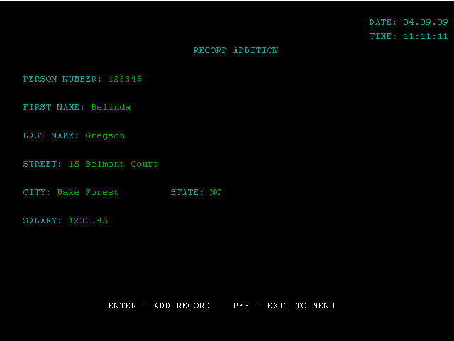
3270 Terminal Characteristics – Vocabulary
A 3270 terminal device is a field oriented display
  Screen divided into user defined fields
  Each field has characteristics, determined (programmed) by ATTRIBUTE BYTES – which assume the first character of each field
      Each attribute byte is displayed as a space, but it is NOT available for data entry
With BMS you send and receive data to/from 3270 terminals using BMS maps
Field
Attribute
Bytes
Notes:
Developing COBOL with IBM WebSphere Developer for zSeries
Module 10 - CICS BMS maps

Slide 13
BMS Map – Mapset, MAPs and Fields
BMS Mapset definition
A complete BMS map is composed of a Mapset, Map and individual defined fields
A Mapset defines the MAP(s) used by program
A MAP provides for screen formatting
Maps consist of one-to-many Field definitions
A MAPSET is group of screens (1 or more MAPs)
  Normally there is only one MAP per MAPSET
Only three macro’s used to create a BMS map
  See next slide
Usually a ‘Screen Generator’ (like RDz's Screen Painter) is used to develop BMS screens
BMS Map definition
BMS Field definition
  Attribute
  Attribute
  …
B
M
S
M
a
p

BMS Field definition
  Attribute
  Attribute
  …
3270
Terminal
BMS Field definition
  Attribute
  Attribute
  …
…
Notes:
Developing COBOL with IBM WebSphere Developer for zSeries
Module 10 - CICS BMS maps
The basic BMS module is a mapset (DFHMSD).
A mapset is composed of one or more maps (DFHMDI).
A 3270 terminal screen is usually built with a single map, although multiple maps may be used to build sections of the screen.
An individual map is composed of multiple fields (DFHMDF).

Slide 14
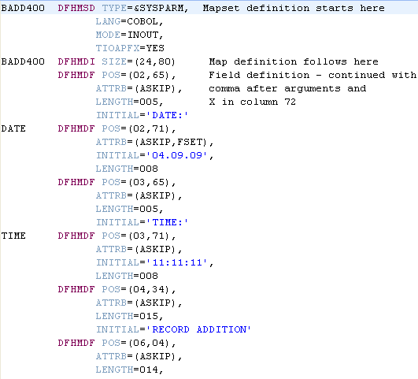
BMS Mapset – Three Native Coding Macros
BMS (native coding) uses assembler macros to define screen layout(s)
  DFHMSD = mapset descriptor (one per mapset)
  DFHMDI = map descriptor initiator (one per map)
  DFHMDF = map descriptor field (one for each map field)
Note: DFH = Always means "CICS"
Labels
BMS
Macros
Attributes

Slide 15
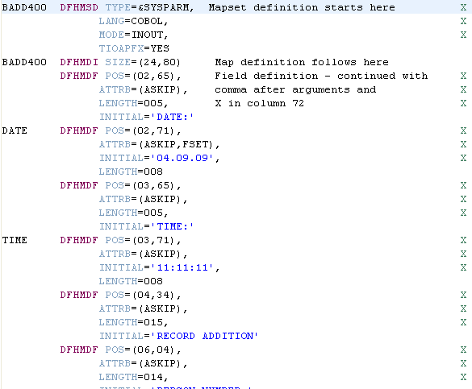



Code BMS Macros
Like most of the IBM assembly languages, BMS is column oriented.
Labels must start in column 1.
Macros (BMS statements) may not extend beyond column 71, unless they are continued to the next line.
  Continue a macro by coding an X in column 72
  Macros may have one or more parameters
  Each parameter is separated by a comma
Comments can be coded after statements and before the continuation character
Labels
Macros
Macro
Parameters
Comments ……………………
Continuation

Slide 16

Define a Mapset
Mapset name ➔
Note: in most cases
should limit to seven
characters
…other Map and Field macros…
To define the mapset.
  <MapsetName> DFHSMD TYPE=(type of mapset),
  MODE=<how map is used>,
  CTRL=FREEKB, (Note: FREEKB is the default)
  LANG=<language>,
  TIOAPFX=YES,
  …
To end a mapset definition
  DFHSMD TYPE=FINAL
See Notes
Notes:
Developing COBOL with IBM WebSphere Developer for zSeries
Module 10 - CICS BMS maps
BADD400 DFHMSD TYPE=&SYSPARM, --- Note, by coding &SYSPARM the assembler generates an executable map, and COBOL map record
MODE=INOUT,
TERM=ALL,
LANG=COBOL,
TIOAPFX=YES,
CTRL=FREEKB,
Maps and field definitions go here
DFHMSD TYPE=FINAL
END

Slide 17

Define a Map
MENU013 DFHMDI SIZE=(24,80),
LINE=1,
COLUMN=1 (note – defaults)
The DFHMDI macro defines the physical characteristics of the 3270 screen:
  Screen size
  Start byte (Line=1,Column=1)
  etc.
80
Columns
24
Lines

Slide 18
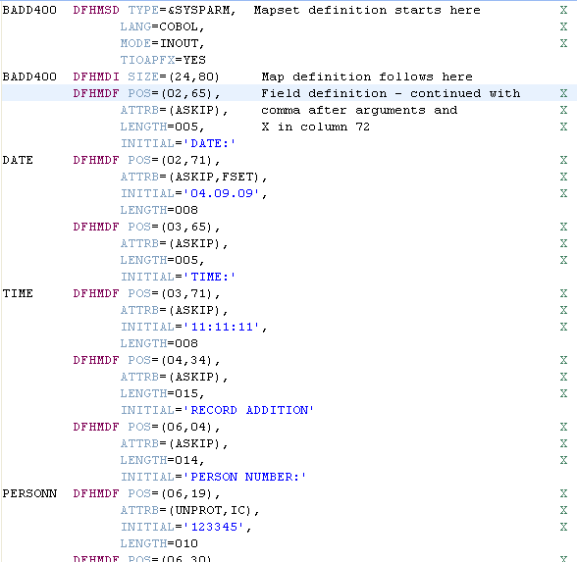
Define Fields
DFHMDF POS=(7,10),
LENGTH=10,
INITIAL='LAST NAME:',
ATTRB=ASKIP
LNAME DFHMDF POS=(7,21),
LENGTH=20,
ATTRB=(UNPROT,IC)
MESSGE DFHMDF POS=(5,10),
LENGTH=64,
ATTRB=(PROT,BRIGHT)
Field
Label
Field
Macro
Statement
⬅ Col. 72
Continuation
See Slide Notes
Notes:
Developing COBOL with IBM WebSphere Developer for zSeries
Module 10 - CICS BMS maps
A few of the more common DFHMDF attributes
POS Position – describes the line/column placement on the screen of the field
BRT High intensity display
NORM Normal intensity
DRK Not displayed (Hidden)
PROT Protected – no data keyed
UNPROT Data may be keyed in
IC Initial cursor position
FSET MDT set ON for field
Protection Attribute
Protected – user can’t key data in field
Unprotected – user allowed to key data
Auto-Skip – cursor skips to next field
Used to mark end of data entry field
Cursor automatically moves to next field
Intensity Attribute
Normal – shown normal intensity
Bright – shown in high intensity
No-display – not shown (background)
Used for password entry
Also used to ‘hide’ data on screen

Slide 19

BMS Quiz
Based on the BMS statements below,
  Fill in the screen capture on the left, with the proper names for the Mapset/Map(s) where the underscores currently exist. Then answer the following questions:
    What are the names of the two BMS maps?
    What is the size of the MAPB 3270 device?
    Where is the cursor initially going to be placed?
    What are the names of the four fields in MAPA?
    Where will "Enter Key" be placed on the 3270 screen?
    What does the PROT attribute do for a field?
MAPSET1 DFHMSD LANG=COBOL,
MAPA DFHMDI SIZE=(32,80)
DFHMDF POS=(2,31),
INITIAL=“My 3270 Map”,
DFHMDF POS=(5,9),
INITIAL=“Enter Key”
LNAME DFHMDF POS=(7,21),
LENGTH=20,
ATTRB=(UNPROT,IC)
MESSGE DFHMDF POS=(5,10),
LENGTH=64,
ATTRB=(PROT,BRIGHT)
MAPB DFHMDI SIZE=(24,80)
…
MAPSET1 DFHMSD TYPE=FINAL
END
Notes:
Developing COBOL with IBM WebSphere Developer for zSeries
Module 10 - CICS BMS maps
The basic BMS module is a mapset (DFHMSD).
A mapset is composed of one or more maps (DFHMDI).
A 3270 terminal screen is usually built with a single map, although multiple maps may be used to build sections of the screen.
An individual map is composed of multiple fields (DFHMDF).

Slide 20
Objectives
After having completed this unit, you should now be able to:
  Describe the types of 3270 data streams available to CICS applications
  Define the three BMS macros
  Define an "attribute byte"
  Describe how to code BMS macros (manually)
  List a few of the BMS field macro attributes
Notes:
Developing COBOL with IBM WebSphere Developer for zSeries
Module 10 - CICS BMS maps
http://publib.boulder.ibm.com/infocenter/cicsts/v3r1/index.jsp?topic=/com.ibm.cics.ts31.doc/dfhp3/dfhp3bj.htm

Slide 21
The RDz Workbench
UNIT
Topics:
BMS Terms and Concepts
The RDz BMS Map Editor
Appendix

Slide 22

Objectives
After completing this unit, you should be able to:
  List the features of the BMS map editor
  Use the BMS map editor to create several different kinds of BMS screens
  Describe how to import existing BMS maps
  Show how to generate BMS maps
  List the outputs of the generate process
  Describe how to deploy BMS maps on z/OS
  Describe how to run and test BMS-map applications
The RDz Help system has excellent documentation
From the menu: Help > Help Contents Search on: Using the BMS Map Editor
      From the inline help on the BMS Map Editor, check out the Tutorial – available as a hyper-link in the help text
and a tutorial on using the BMS Editor
Notes:
Developing COBOL with IBM WebSphere Developer for zSeries
Module 10 - CICS BMS maps
http://publib.boulder.ibm.com/infocenter/cicsts/v3r1/index.jsp?topic=/com.ibm.cics.ts31.doc/dfhp3/dfhp3bj.htm

Slide 23
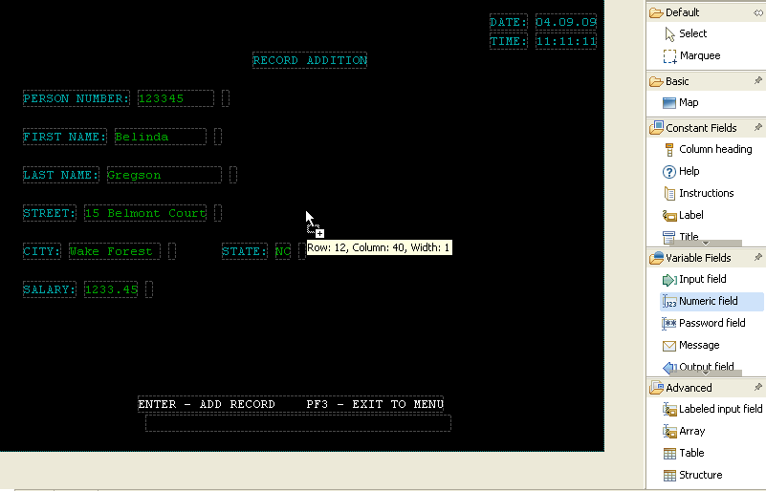
Coding a BMS Mapset …vs… Creating a BMS Mapset
Options for BMS developers…
 1. Grueling native BMS hand-coding …
 2. RDz Drag & Drop Development…
Notes:
Developing COBOL with IBM WebSphere Developer for zSeries
Module 10 - CICS BMS maps
Actually, 3 ways to code BMS
Coding DFHxxx macros in a file by hand
Using a 3270-based tool like Screen Definition Facility II (SDF II)
Using a graphical editor like the BMS Map Editor in Rational Developer for System z … we think RDz is easiest ☺

Slide 24
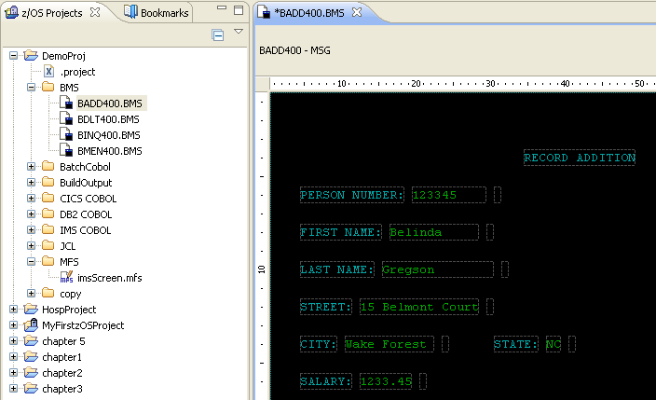
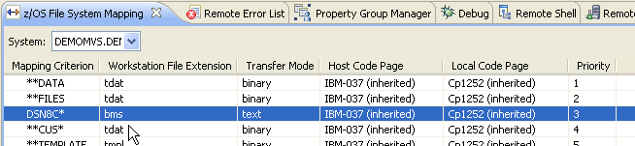
Loading a BMS Mapset into the Design Canvas
The BMS editor opens on a file recognized as a BMS map set.
For an existing z/OS file, the file or dataset must:
  Be named with an extension of .BMS
  … or be mapped to a .bms file extension using the z/OS Mapping System view

Recall from a previous unit (RDz Workbench – and z/OS Debugging) how to map an MVS file-type to a Workstation file extension
Notes:
Developing COBOL with IBM WebSphere Developer for zSeries
Module 10 - CICS BMS maps

Slide 25
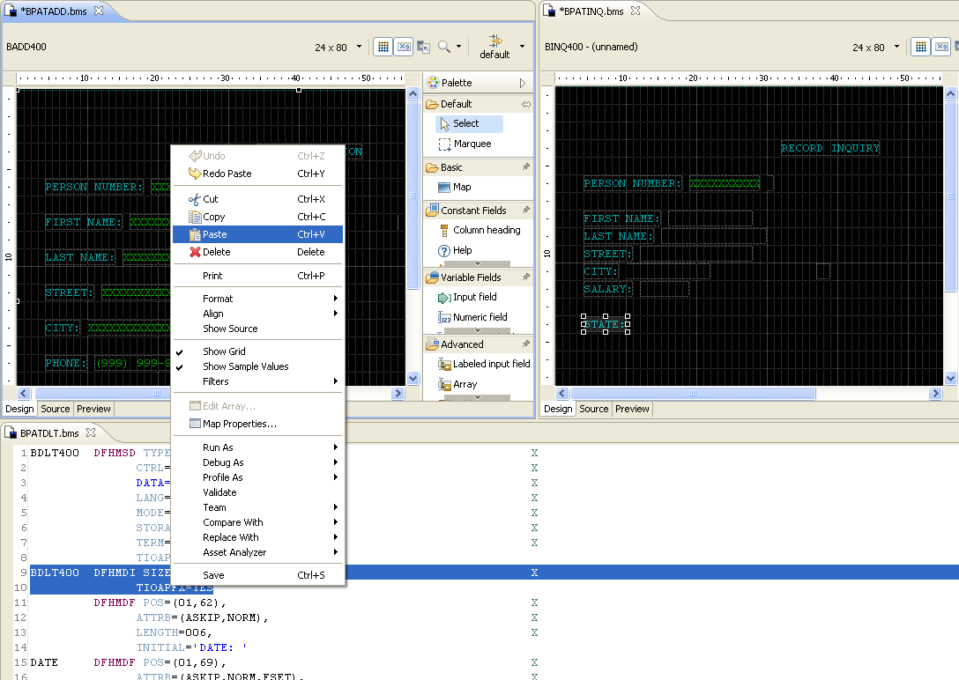
Eclipse Tooling/Features – and the BMS Editor
All of the graphical capabilities of Eclipse can be utilized effectively:
  Multiple, windowed editing frames
  Select/Cut/Copy/Paste between editing frame
  Etc.

Slide 26
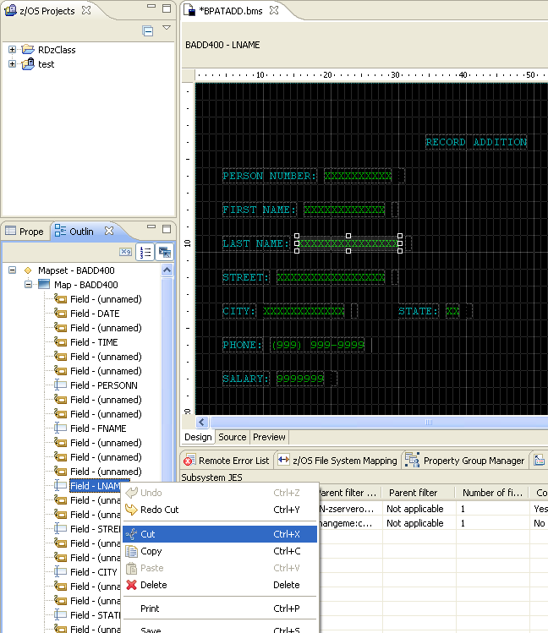
The Outline View
Just like the rest of the file editing you've done this week, the Outline view synchronizes with your development activity, and can be used effectively
Features:
  Synchronized selection between the Outline view and editor
  You can navigate through the Outline view and:
    Select
    Cut
    Copy
    Paste
    Delete
  Note that these operations will affect the BMS source macros

Slide 27

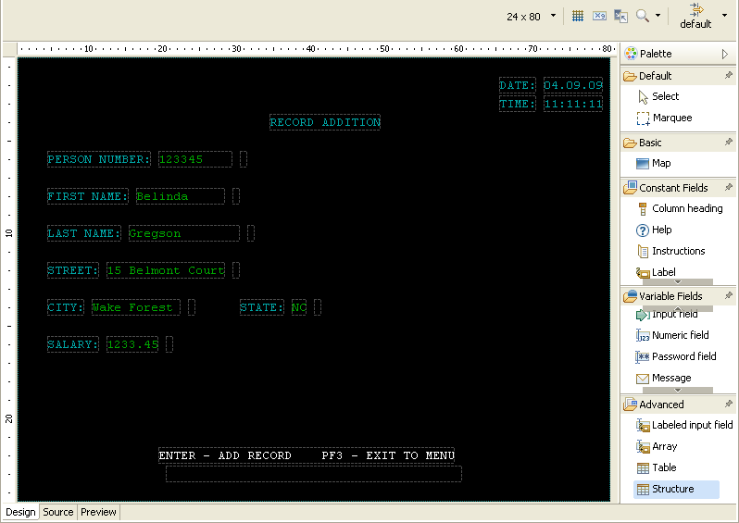
The BMS Map Editor – Overview
Map Editor Toolbar
Row, Column Rulers
Design Canvas
Viewing
modes
Palette
(Tools)
Let's start by looking at the different Viewing modes…
Notes:
Developing COBOL with IBM WebSphere Developer for zSeries
Module 10 - CICS BMS maps
The editor itself has three tabs:
Design: contains a drawing canvas where you can place maps and fields
Source: is a text editor, synchronized with the Design tab, where you can directly code or view the macro source code
Preview: shows what the map will look like on a terminal
The three-tabbed approach for this editor is similar to what you see for many of the other graphical editors in Eclipse such as the HTML and JSP editors.
The map set was switched to white mode because it is much easier to see the fields. Black/white mode will be explained shortly.
“Map set” is underlined because you need to reinforce that the editor works on map set files, not maps.

Slide 28
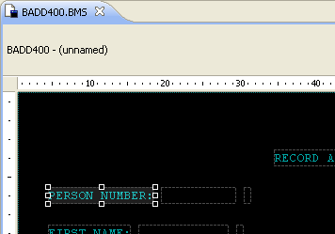
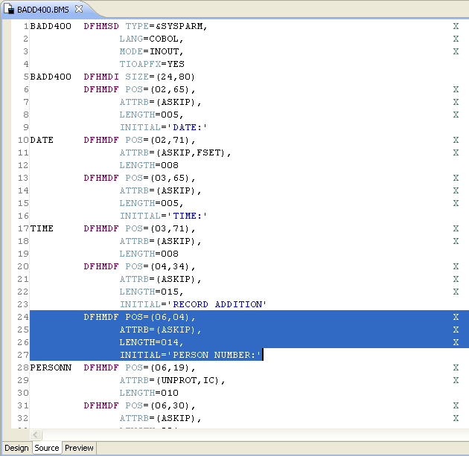
Source View Mode
Displays your BMS file in source (macro/assembler) mode
  Customized color highlighting
  Line numbers
  Syntax error markers
Field selection is maintained between Design ⬅➔ Source mode
At any time during your BMS work you can flip from Design → Source → Preview mode
Notes:
Developing COBOL with IBM WebSphere Developer for zSeries
Module 10 - CICS BMS maps
Elements selected in the Design tab will cause that element to be emphasized in the Source tab, and vice versa.

Slide 29
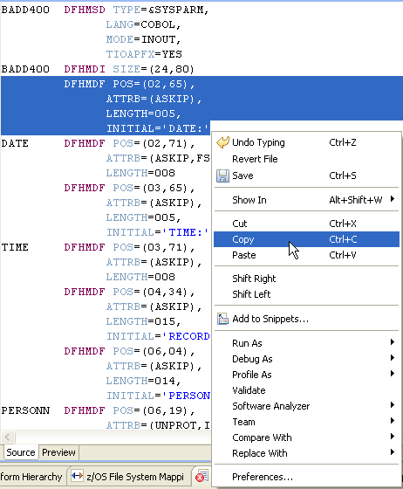
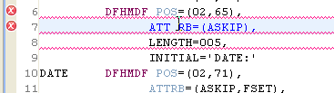
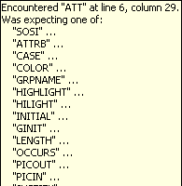
Source View Mode – Context Menu Options
Standard source-level development editing options available:
  Save
  Cut
  Copy
  Paste
  Shift Right/Left
  Snippets
  Compare/Replace With (next slide)
Also, good in-place syntax validation
Notes:
Developing COBOL with IBM WebSphere Developer for zSeries
Module 10 - CICS BMS maps

Slide 30
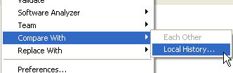
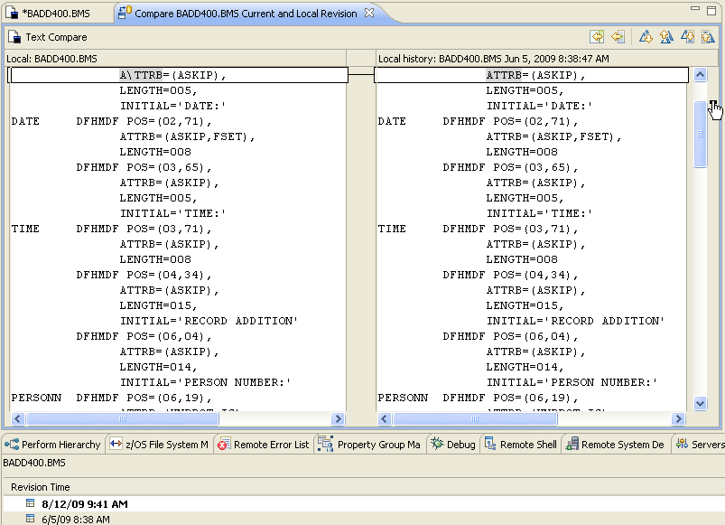
Source View Mode – Compare/Replace With Options
Same functionality as the LPEX editor for source files
Notes:
Developing COBOL with IBM WebSphere Developer for zSeries
Module 10 - CICS BMS maps

Slide 31
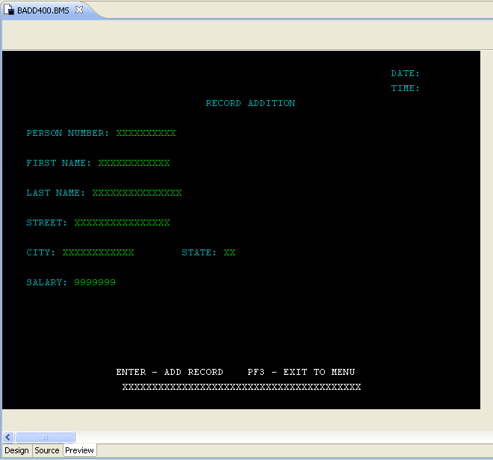

Preview Mode
Here is the same BMS dataset in Preview mode
  Note that we have set Toggle Sample Values "on" in Design mode, for this screen capture
Preview mode is basically for screen documentation, design-reviews and prototyping your 3270-U.I.
  There is no application COBOL/CICS Send/Receive logic executing
  But you could use Preview mode effectively during U.I. Design/JAD sessions with business users
 Most of your work will be done using the Design Mode – so let's return to that, and see what it has to offer BMS developers
Notes:
Developing COBOL with IBM WebSphere Developer for zSeries
Module 10 - CICS BMS maps

Slide 32
The BMS Map Editor – Design Mode
Provides "declarative development" facilities for painting 3270/BMS screens, or doing:
Screen maintenance
Mapset development (from scratch)
Map Editor Toolbar➔

Design Canvas
Palette
Tools &
Widgets
We'll continue by looking at the Map Editor Toolbar display options…
Notes:
Developing COBOL with IBM WebSphere Developer for zSeries
Module 10 - CICS BMS maps
“Map set” is underlined because you need to reinforce that the editor works on map set files, not maps.

Slide 33


BMS Editor – Toolbar Display Options (Part 1 of 2)
Display options enable you to control how Mapsets are displayed in the editor at design time.
  Size – drop-down list to select a new size for the Map
  Toggle Gridlines – shows or hides a grid over the form to help in sizing and arranging fields
  Toggle Sample Values – shows or hides sample values for input fields, which are otherwise invisible unless they have the Initial property specified
Note: Feel free to try any/all of these design and display options while reading through these slides
Notes:
Developing COBOL with IBM WebSphere Developer for zSeries
Module 10 - CICS BMS maps
You can set defaults for using 4 color mode and displaying the rulers in the Window -> Preferences -> EGL -> Text Form Editor preferences. Note that 4 color mode only has an effect if all variable and constant fields for the form are defined with defaultColor. If any variable or constant field on the form has a color other than defaultColor, the actual colors specified for all variable and constant fields are based on the color property.
You can set the color of the gridlines in the Window -> Preferences -> EGL -> Text Form Editor preferences.
Sample values provides a quick way to see how “busy” the form is when the fields are completely filled.
Except for Size, the display options have no effect on the form at runtime.

Slide 34

BMS Editor – Toolbar Display Options (Part 2 of 2)
Display options enable you to control how Mapsets are displayed in the editor at design time.
  Toggle Black and White Mode – switches the editor between black and white mode and full color mode using the default background color
  Zoom level – sets the magnification level of the editor
  Filters (see next slide)
Notes:
Developing COBOL with IBM WebSphere Developer for zSeries
Module 10 - CICS BMS maps
When you are developing a new form, using Black and White Mode (white background with black fields) can be easier on the eyes. When you need to have a better idea of how the form will appear at runtime, toggle Black and White Mode off to see the default background color with the fields in full color based on the color property.
VAGen customers: Toggle Sample Values is a new capability in EGL.

Slide 35
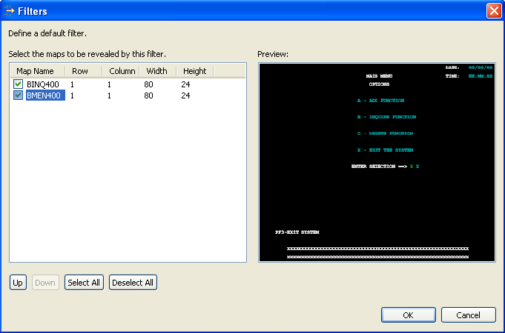
BMS Editor – Filters
Filters enable you to:
  Focus on just one Map within a Mapset
  Review the appearance of a popup form and its underlying form
  Select or deselect to filter the forms you want to include in the default filter
Note that if your Mapsets contain one Map – Filters will not be as useful an option as others you will come across
Notes:
Developing COBOL with IBM WebSphere Developer for zSeries
Module 10 - CICS BMS maps
\

Slide 36
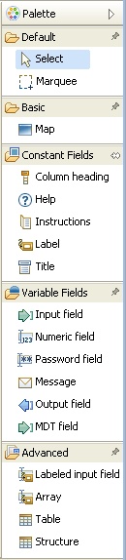
BMS Editor – Palette View
Used to add new BMS elements (Maps and Field elements) to a BMS screen – by dragging and dropping onto the Design Canvas
Select – Allows you to select a field and sets focus on that field
Marquee – Allows you to select multiple fields at once
Map – Select this option to create a new Map within a Mapset
Constant Fields – display a string of text that does not change in a Map. Unlike variable fields, constant fields cannot be accessed by you COBOL or PL/I code
Variable Fields – serve as input or output data in a Map. Each variable field is based on an COBOL field. Variable fields can be accessed by your COBOL or PL/I code
Advanced – assist you in creating standard but more complex text form elements such as arrays, records.
Notes:
Developing COBOL with IBM WebSphere Developer for zSeries
Module 10 - CICS BMS maps
Marquee is the same as having the Select option set and holding the Ctrl button down as you right click the fields you want to select. The purpose of this is usually to move groups of fields around on the screen.
The Window -> Preferences -> EGL -> Text Form Editor -> Palette Entries preferences enable you to set the following information:
Text and print forms – default size for the form
Constant fields – default color, intensity, highlight, and protect for various types of constant fields that you might use.
Variable fields – default length color, intensity, highlight, and protect for various types of variable fields that you might use.
Popup Form – vertical and horizontal characters to surround the form, as well as default color, intensity, highlight, and protect for the border.

Slide 37
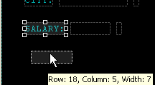




BMS Map Enhancements – Using the Palette – 1 of 6
Let's add phone# as a new literal and field to BADD400.BMS. To that we'll:
  Select and move the existing/related Salary fields down two rows
  Add a literal and input field
Selecting and dragging BMS fields – options:
  To select a single field, simply:
    Left-Click the field to set focus
    (Holding down the left mouse button) Drag the field to its destination
  To select multiple fields:
    Hold down the Ctrl key
      Left-Click each field you wish to select
      (Holding down the left mouse) Drag the fields to their destination
  Or use the Marquee selector:
    Click the Marquee selector (this allows you to "lasso a rectangular group of fields)
    (Holding down the left mouse button) Lasso the fields and select them
    Change selector back to an arrow pointer
    (Holding down the left mouse button) Drag the field to its destination
Note that you could also use your PC's up/down/right/left arrows – to select (not move, just select) fields in your BMS map
Notes:
Developing COBOL with IBM WebSphere Developer for zSeries
Module 10 - CICS BMS maps

Slide 38
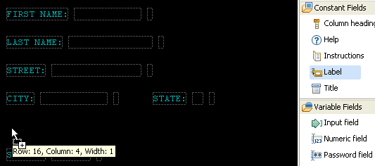

Using the Palette – 2 of 6 – Adding New Fields
Add a new Label to Row 16, column 4 - from the Palette
  Left-click to select: Label
  Holding down the left-mouse button
    Drag the mouse pointer to:
      Row: 16
      Column: 4
    Drop
  Type in the label's text: PHONE:
A few things:
  You will notice that the widget's color is blue (not turquoise). This can be:
    Changed for this one label (next slide)
    Changed for all new labels (from BMS Editor Preferences – covered in a bit)
  If you make an mistake and drop the field in the wrong place – or you type something else that needs fixing, you will find it easy to modify every element of your BMS field
    Next slide…
Notes:
Developing COBOL with IBM WebSphere Developer for zSeries
Module 10 - CICS BMS maps

Slide 39
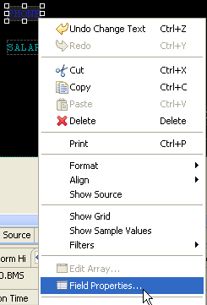
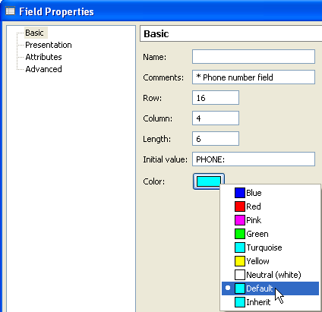
Using the Palette - 3 of 6 - Customizing Field Properties
The BMS Editor allows you to modify every element of your screen using a consistent Properties dialog
  Right-click over the field
  Select Field Properties…
From Field Properties you can customize virtually any element of a BMS screen field:
  From Basic:
    Enter BMS field name
      Note that labels are rarely named in BMS maps
    Add a comment
    Alter the layout R/C
    Change field length
    Modify initial value
    Change color
      Click the color tablet
The Field Properties dialog is available for new, or existing (from an imported BMS) map fields

Notes:
Developing COBOL with IBM WebSphere Developer for zSeries
Module 10 - CICS BMS maps

Slide 40
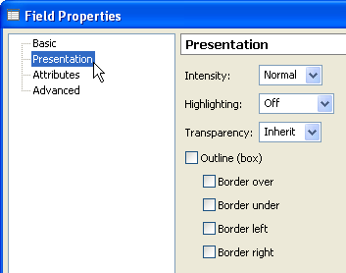
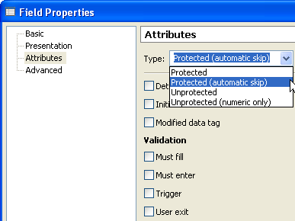
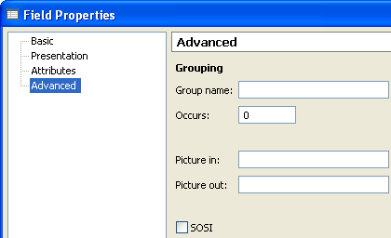
Using the Palette – 4 of 6 – Additional Field Properties
Besides Basic there are three additional Field Properties dialogs:
  Presentation:
    Intensity, Highlighting, Transparency
    Different types of boxed outlines
  Attributes:
    Disabling/Enabling data entry
    Adding Validation logic
  Advanced:
    Gives you control over the creation of COBOL group data structures to handle sub-elements of a field with individual variables – yet be able in COBOL to address the entire group as a single structure
      Example: mm / dd / yyyy - could be thought of a single date group field, composed of five elementary items (see Slide Notes)
Notes:
Developing COBOL with IBM WebSphere Developer for zSeries
Module 10 - CICS BMS maps
Grouping
Sometimes, you have to refer to subfields within a single field on the display. For example, you may have a date field that appears on the screen like this:
03-17-92 It is one field on the screen (with one attributes byte, just before the digit "0"), but you must be able to manipulate the month, day, and year components separately in your program. You can do this with a "group field", using the GRPNAME option of the DFHMDF macro. To create one, you code a DFHMDF macro for each of the component subfields; each definition names the same group field in the GRPNAME option.
To define the date above as a group field starting at the beginning of line 10, for example, we would write:
MO DFHMDF POS=(10,1),LENGTH=2,ATTRB=BRT,GRPNAME=DATE
SEP1 DFHMDF POS=(10,3),LENGTH=1,GRPNAME=DATE,INITIAL='-'
DAY DFHMDF POS=(10,4),LENGTH=2,GRPNAME=DATE
SEP2 DFHMDF POS=(10,6),LENGTH=1,GRPNAME=DATE,INITIAL='-'
YR DFHMDF POS=(10,7),LENGTH=2,GRPNAME=DATE
These definitions produce the following in the symbolic output map:
02 DATE.
03 FILLER PICTURE X(2).
03 MOA PICTURE X.
03 MOO PIC X(2).
03 SEP1 PIC X(1).
03 DAO PIC X(2).
03 SEP2 PIC X(1).
03 YRO PIC X(2).

Slide 41


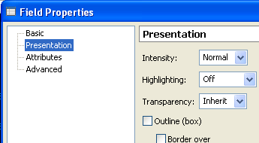
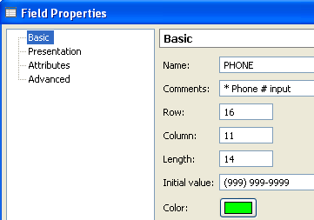
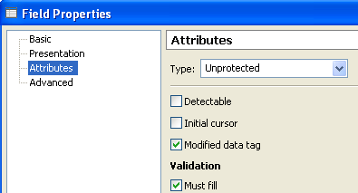
Using the Palette – 5 of 6 – Add an Input Field
Add a new Input Field to Row 16, column 11 - from the Palette
  Left-click to select: Input Field
  Holding down the left-mouse button
    Drag the mouse pointer to:
      Row: 16
      Column: 11
    Drop
    (optional) Using your mouse, stretch (resize) the new input field as shown➔
Customize the input field's properties:
    As shown in the screen captures here
    Or – feel free to experiment with your own options for this new field (this is not a production map)
Notes:
Developing COBOL with IBM WebSphere Developer for zSeries
Module 10 - CICS BMS maps

Slide 42
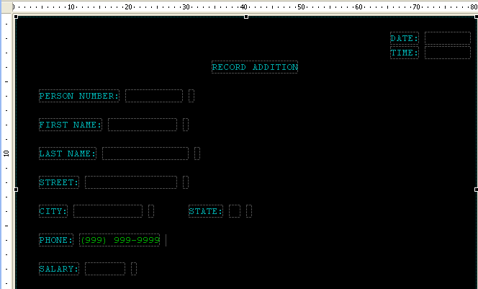
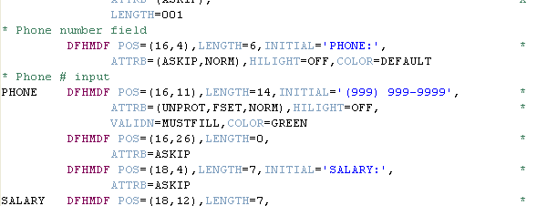
Using the Palette – 6 of 6 – Finished Enhancement
Added – Phone number field with literal label and initial value
If you already know BMS, consider looking at the Source view to see what has been generated for your Fields
 Suggestion
Spend a few minutes with either the class BMS file or your own throw-away dataset, to experiment with these and other options from the toolbar/Palette
Notes:
Developing COBOL with IBM WebSphere Developer for zSeries
Module 10 - CICS BMS maps

Slide 43
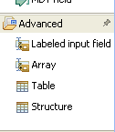
Defining Table Structures
Three options exist for creating BMS U.I. tables
Each option is a little different.
  However for all:
    A wizard lets you define the field specification.
    The array is created starting at the location of the mouse-click
    Field name validation is provided.
    Overlap on the screen is also detected
Array
  Define a single field that will be repeated on the screen a specified number of times either vertically or horizontally.
Table
  Define a single-or-multi-dimensional table of fields
Structure
  The “Structure” palette item allows you to define a structure of one or more fields, and also specify the number of times this “structure” needs to be repeated on the screen.
  The structure is repeated vertically on the screen
  You must specify the row and column offset for each of the field in the structure. These offsets are from the point of the original mouse-click on the screen
We will show examples of each. You can decide based on your requirements and experience which to use in your production BMS.
Notes:
Developing COBOL with IBM WebSphere Developer for zSeries
Module 10 - CICS BMS maps

Slide 44
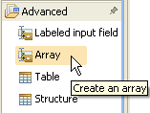
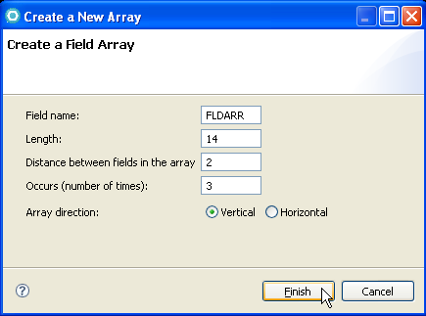
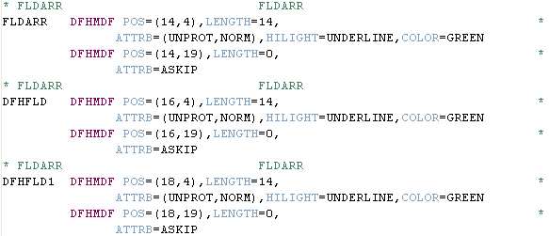
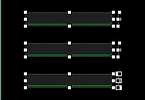
Define an Array
Steps:
Ensure that space is available on your Map
Drag & Drop an Array widget from the Palette to your Map location
Respond to the prompts:
  Name – Fieldname
  Length – Individual field length
  Distance:
    If Vertical, # of rows between fields
    If Horizontal, # of columns between fields
  Array direction
Generated BMS statements
Array U.I. – in Design view
Notes:
Developing COBOL with IBM WebSphere Developer for zSeries
Module 10 - CICS BMS maps

Slide 45
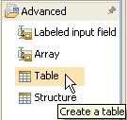
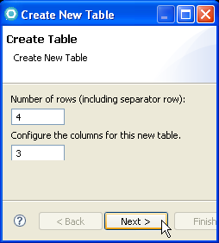
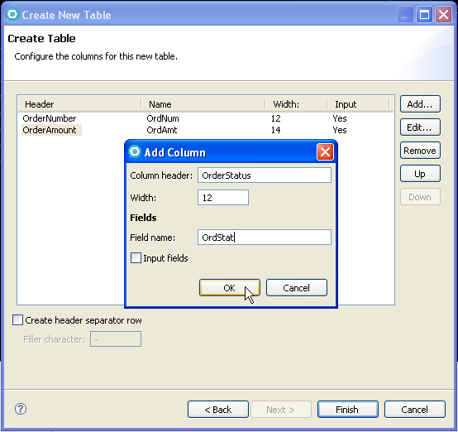
Define a Table – 1 of 2
Respond to the prompts in the first dialog:
  Number of rows
  Number of columns
For each column to be added:
  - Click Add…
  - Enter the Column Header, Width and Field name
    Be sure that the Width is wider than the Column header literal
  - Specify ☑ Input (y/n)
  - Can Edit… or Remove columns during this dialog
Notes:
Developing COBOL with IBM WebSphere Developer for zSeries
Module 10 - CICS BMS maps
When dropping the table tool on the Design tab, a Create New Table wizard appears. This allows you to specify the dimensions of the table, and the particulars of each column.
The Field name prefix in the Edit Column dialog lets you set the prefix of the generated name for the field. A number will be suffixed to the name foe each row in the table.

Slide 46
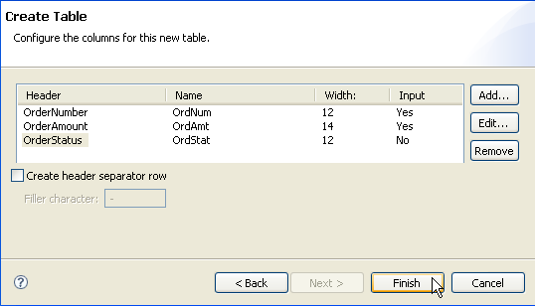
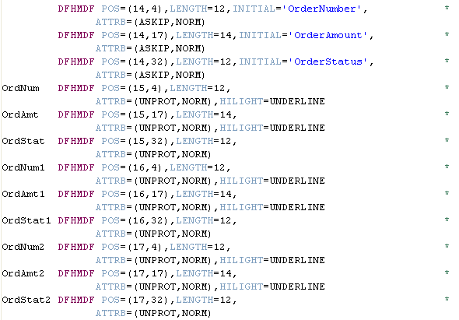
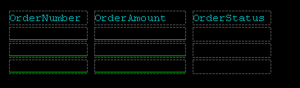
Define a Table – 2 of 2
Completed Dialog (Click Finish when done)
Can create header row with separator ➔
Generated BMS statements
Table U.I. – in Design view
Notes:
Developing COBOL with IBM WebSphere Developer for zSeries
Module 10 - CICS BMS maps

Slide 47
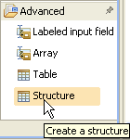
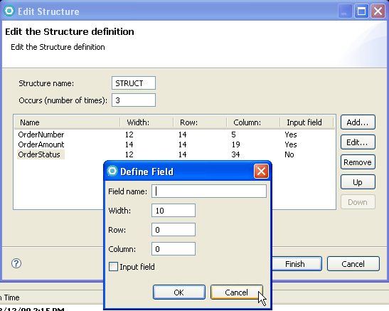
Define a Structure – 1 of 2
Respond to the prompts in the dialogs and click Finish
  Structure name
  How many row occurrences
  For each column:
    Click Add.. And specify:
      Field name:
      Field width
      Row offset:
        How many blank rows to generate between data rows
      Column offset:
        Number of bytes (you calculate) to the right, relative to the first column in the structure
    Can Edit… entered specifications
    Can also:
      Remove
      Move columns to the right or left by selecting: Up/Down
Notes:
Developing COBOL with IBM WebSphere Developer for zSeries
Module 10 - CICS BMS maps
A structure is very much like a Table's implementation in BMS macros. The wizard to build it is a little different.

Slide 48

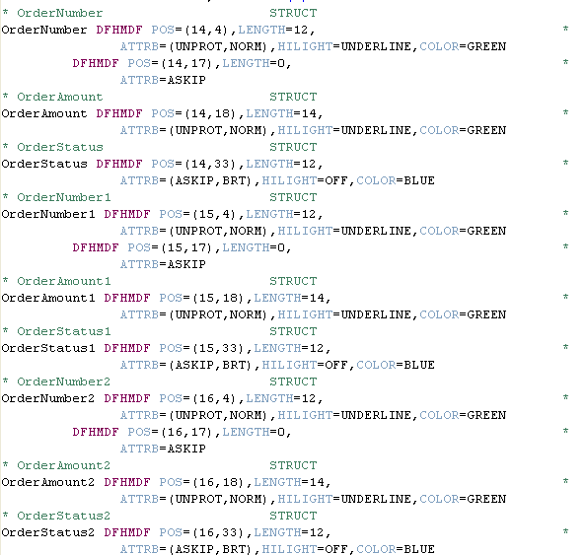
Define a Structure – 2 of 2
Generated BMS statements
Structure U.I. – in Design view
Finished Dialog from previous slide
Notes:
Developing COBOL with IBM WebSphere Developer for zSeries
Module 10 - CICS BMS maps

Slide 49
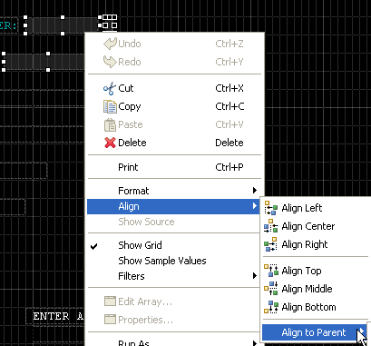
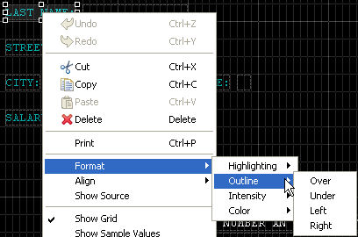
The BMS Map Editor – Context Menu – 1 of 2
The context menu has a few additional capabilities when in Design view:
Show Sample Values
Select field(s)
  Alignment options ➔
  Format options
    Same as the Properties dialogs
Design View mode
with ✓ Show Grid
Notes:
Developing COBOL with IBM WebSphere Developer for zSeries
Module 10 - CICS BMS maps
“Map set” is underlined because you need to reinforce that the editor works on map set files, not maps.

Slide 50




The BMS Map Editor – Context Menu – 2 of 2
Other Context Men options continued:
Print (to local printer)
Show Source (context sensitive):
  Of field
  Of Map
Print
Show Source
Notes:
Developing COBOL with IBM WebSphere Developer for zSeries
Module 10 - CICS BMS maps
“Map set” is underlined because you need to reinforce that the editor works on map set files, not maps.

Slide 51


BMS Form Editor – Properties and Outline Views
The Properties view displays the BMS properties of the Mapset, Map, or field that is currently selected in the editor.
The Outline view displays a hierarchical view of the Mapset that is open in the editor.
The RDz views are synchronized with what is selected in the BMS editor
*** See Slide Notes
See Notes
Notes:
Developing COBOL with IBM WebSphere Developer for zSeries
Module 10 - CICS BMS maps
The Properties view displays property value information for a field or map that is selected in the Design canvas or the Outline view. For a map set, the following properties are displayed:
Language
Map type
Name
For a map, the following properties are displayed:
Column
Height
Name
Row
Width
For a field, the following properties are displayed:
Column
Group name
Initial value
Length
Name
Occurs
Row
Type

Slide 52
Creating a New BMS Mapset
Besides maintaining existing BMS, you may wish to create completely new Mapsets/Maps using the BMS editor.
Here are the steps:
      Create New BMS Mapset and Map
      Customize the Map Properties
      Use the Palette widget tools (as shown before) to create individual BMS fields and to customize field properties
Optionally – You can generate JCL for assembling your map using z/OS project tooling
And – You can customize the BMS map editor's preferences
Notes:
Developing COBOL with IBM WebSphere Developer for zSeries
Module 10 - CICS BMS maps
New map sets can be added to local or remote projects. If a remote project is selected (in a previous dialog of this wizard), “Add to MVS project” is enabled.
“Language” is specified to create the symbolic map for the appropriate language.
“Type” of &SYSPARM specifies that the type of output from the map set assembly (physical or symbolic) is indicated by the SYSPARM option in the assembly JCL.

Slide 53




1. Create New BMS Mapset
From the File menu, select:
  New > Other…
  From the New dialog, type: Map and select BMS – Map Set
  Select a Folder for your new Mapset (if created on z/OS), or if creating on your workstation, select a Project location
  4. Enter high-level Map Set properties
  5. Click Finish
Notes:
Developing COBOL with IBM WebSphere Developer for zSeries
Module 10 - CICS BMS maps
New map sets can be added to local or remote projects. If a remote project is selected (in a previous dialog of this wizard), “Add to MVS project” is enabled.
“Language” is specified to create the symbolic map for the appropriate language.
“Type” of &SYSPARM specifies that the type of output from the map set assembly (physical or symbolic) is indicated by the SYSPARM option in the assembly JCL.

Slide 54

New Mapset and Map – 1 of 4
After you click finish in the new Map Set wizard, a new file will be created and your new Mapset and default Map combination will open into the Design Canvas.
Customize the Map Properties… from the Context Menu
Notes:
Developing COBOL with IBM WebSphere Developer for zSeries
Module 10 - CICS BMS maps

Slide 55



New Mapset and Map – 2 of 4
You can use the same Properties dialogs, to customize your Map's BMS macros:
  DFHMSD
  DFHMDI
Notes:
Developing COBOL with IBM WebSphere Developer for zSeries
Module 10 - CICS BMS maps

Slide 56


New Mapset and Map – 3 of 4
Map and Mapset property customization, continued
Notes:
Developing COBOL with IBM WebSphere Developer for zSeries
Module 10 - CICS BMS maps

Slide 57


New Mapset and Map – 4 of 4
Consider viewing the new Mapset in the Source mode ➔
If for no other reason than to gain an understanding of cause/effect in setting the Map/Mapset custom properties
Use the Palette widget tools (as shown before) to create individual BMS fields and to customize field properties
Notes:
Developing COBOL with IBM WebSphere Developer for zSeries
Module 10 - CICS BMS maps

Slide 58
The RDz Workbench
UNIT
Topics:
BMS Terms and Concepts
The RDz BMS Map Editor
Generating Symbolic and Physical Maps
Appendix

Slide 59

Generating Your BMS Maps
There are a couple of ways of generating the symbolic maps for BMS Maps.
  The first option is via the JCL generation and submitting the generated JCL.
    This will give both the symbolic map and the physical map.
  The second option (valid only for generating COBOL copybooks) is done without actually assembling the BMS macros.
    This is valid for both local and remote BMS resources.
How to:
  Select any BMS file,
  Right-click and Generate > Symbolic map
A similar function is available for MFS files also (as of RDz7.6 release).
  Again, this is only valid for COBOL for now. IBM has open requirements for similar support for PL/1.
Slide Notes
Notes:
Developing COBOL with IBM WebSphere Developer for zSeries
Module 10 - CICS BMS maps

Slide 60

Property Groups and Generated JCL for a Mapset
You will probably need to customize the High-level qualifier for the Object and Load (DSCTLIB) libraries
    The default is for the generated JCL to pick up your own
Notes:
Developing COBOL with IBM WebSphere Developer for zSeries
Module 10 - CICS BMS maps
The object module output is used as input for the link that produces the physical map.

Slide 61

Property Groups and Link Options for a Mapset
You will probably also need to customize the High-level qualifier for the Load Module location on the Link Options
The default is for the generated JCL to pick up your own Load lib.
Although you can point to a library in the CICS RPL (Relocate-able Program Library) concatenation list
Notes:
Developing COBOL with IBM WebSphere Developer for zSeries
Module 10 - CICS BMS maps
The CICS RPL is the concatenated list of load libraries usually containing the application load modules.

Slide 62

The Application Entry Point Properties
Right-click over the folder name and select Properties
Be sure to specify High Level Assembler for your BMS
Notes:
Developing COBOL with IBM WebSphere Developer for zSeries
Module 10 - CICS BMS maps
It is common that the Folder or Project level properties for the entry point is COBOL. If you do not specify “High Level Assembler”, you will get errors on the link-edit of the physical map.
The CICS RPL is the concatenated list of load libraries usually containing the application load modules.

Slide 63


Building the Mapset - Symbolic map
Generate JCL for Assemble
Add a suffix to the JCL member name
Submit the JCL
Check the JES output for return codes
Symbolic map now available for program compile
Notes:
Developing COBOL with IBM WebSphere Developer for zSeries
Module 10 - CICS BMS maps
The suffix is added to the JCL member name since you generate JCL twice from the same map set. This allows you to be able to maintain both sets of JCL for later submissions.
The return codes from the job should be 4 or less.
The symbolic map is placed in the library specified in the BMS Settings property “BMS DSCTLIB Library”. It is frequently a COBOL COPYBOOK library.
After the successful execution of this JCL, a program that uses this map set can use the symbolic map/map set in a compile.
The CICS RPL is the concatenated list of load libraries usually containing the application load modules.

Slide 64


Building the Mapset - Physical Map
Generate JCL for Assemble Link
Add a suffix to the JCL member name
Submit the JCL
Check the JES output for return codes
Physical map now available for use in CICS load library
Notes:
Developing COBOL with IBM WebSphere Developer for zSeries
Module 10 - CICS BMS maps
The suffix is added to the JCL member name since you generate JCL twice from the same map set. This allows you to be able to maintain both sets of JCL for later submissions.
The return codes from the job should be 4 or less.
The physical map is placed in the library specified in the Link Options property “Load Module Location”. This is usually a CICS load library.
The CICS RPL is the concatenated list of load libraries usually containing the application load modules. In actuality, you could just run the assemble-link JCL, and it would build both the physical and symbolic maps.

Slide 65

Viewing maps on CICS
Place physical map set file in a CICS RPL library
  Can be targeted by Link Options property “Load Module Location”
Define the map set resource to CICS
  CEDA DEFINE MAPSET(myset) GROUP(mygroup)
Make the new map set resource available
  CEDA INSTALL GROUP(mygroup)
View a map in the map set, under CICS
  CECI SEND MAP(mymap) MAPSET(mygroup)
Notes:
Developing COBOL with IBM WebSphere Developer for zSeries
Module 10 - CICS BMS maps

Slide 66
Using BMS maps in a CICS COBOL program
Create the symbolic and physical maps first
  Assemble-Link JCL
Typically use COPY statement to include the map fields in the Data Definition section of the program
Compile COBOL program, including CICS option
Define both program and map set to CICS
  CEDA DEFINE PROGRAM(myprog) GROUP(mygroup)
  CEDA DEFINE MAPSET(mymapset) GROUP(mygroup)
Define transaction to initiate the program
  CEDA DEFINE TRANSACTION(mytr) GROUP(mygroup)
Install resources
  CEDA INSTALL GROUP(mygroup)
Execute transaction!
  mytr
Notes:
Developing COBOL with IBM WebSphere Developer for zSeries
Module 10 - CICS BMS maps

Slide 67


BMS Palette, Widget Field Preferences
All BMS Editor settings can be customized. Especially useful are:
Default names
Palette widget entry Properties
Notes:
Developing COBOL with IBM WebSphere Developer for zSeries
Module 10 - CICS BMS maps
The default settings for constant and variable fields can be viewed and set here.

Slide 68
Checkpoint
True or False: BMS produces a device-dependent data stream
What are the two types of output from BMS assemblies?
How can you make an existing map set open into the BMS Map Editor?
Which view displays a list of BMS elements that you can select and drop onto the Design tab?
What Application Entry Point property is used for a map set assembly?
Which Generate JCL option on the map set creates the physical map needed for execution?
Notes:
Developing COBOL with IBM WebSphere Developer for zSeries
Module 10 - CICS BMS maps
Write down your answers here:
1.
2.
3.
Checkpoint Solutions:
1. False
2. A physical map (TYPE=MAP) is a module that is used to merge variable output from the program with static data in the map. A symbolic map (TYPE=DSECT) is a language-dependent data structure copied into a program.
3. You must associate the file or containing folder with the .bms workstation file extension.
4. The Palette view
5. High Level Assembler
6. Assemble Link

Slide 69

Workshop – Four BMS MAPS
In the Slide Notes is sample BMS code for four simple 3270/BMS screens:
    BADD400
    BMEN400
    BINQ400
    BDLT400
From z/OS Projects:
  Create a \bms\ folder
  Inside the \bms\ folder:
    Create four new files – one for each of the BMS source files in the Slide Notes
  Save each file
    Use .bms as the file's extension
  Ensure there are no syntax errors
Notes:
Developing COBOL with IBM WebSphere Developer for zSeries
Module 10 - CICS BMS maps
Note that the source for these files can also be found at: http://www-949.ibm.com/software/rational/cafe/docs/DOC-3129
Look for: mainframe-resources.txt
#1 – BMEN400.BMS
BMEN400 DFHMSD TYPE=&SYSPARM, X
LANG=COBOL, X
MODE=INOUT, X
TIOAPFX=YES
BMEN400 DFHMDI SIZE=(24,80)
DFHMDF POS=(01,63), X
ATTRB=(PROT,BRT), X
LENGTH=006, X
INITIAL='DATE: '
DATE DFHMDF POS=(01,71), X
ATTRB=(PROT,FSET), X
LENGTH=008, X
PICOUT='X(8)', X
INITIAL='99/99/99'
DFHMDF POS=(02,36), X
ATTRB=(PROT,BRT), X
LENGTH=009, X
INITIAL='MAIN MENU'
DFHMDF POS=(02,63), X
ATTRB=(PROT,BRT), X
LENGTH=006, X
INITIAL='TIME: '
TIME DFHMDF POS=(02,71), X
ATTRB=(PROT), X
LENGTH=008, X
PICOUT='X(8)', X
INITIAL='HH:MM:SS'
DFHMDF POS=(03,37), X
ATTRB=(PROT,BRT), X
LENGTH=007, X
INITIAL='OPTIONS'
DFHMDF POS=(05,33), X
ATTRB=(PROT), X
LENGTH=016, X
INITIAL='A - ADD FUNCTION'
DFHMDF POS=(07,33), X
ATTRB=(PROT), X
LENGTH=020, X
INITIAL='B - INQUIRE FUNCTION'
DFHMDF POS=(09,33), X
ATTRB=(PROT), X
LENGTH=019, X
INITIAL='C - DELETE FUNCTION'
DFHMDF POS=(11,33), X
ATTRB=(PROT), X
LENGTH=019, X
INITIAL='X - EXIT THE SYSTEM'
DFHMDF POS=(13,31), X
ATTRB=(PROT,BRT), X
LENGTH=019, X
INITIAL='ENTER SELECTION ==>'
SELECT DFHMDF POS=(13,51), X
ATTRB=(UNPROT,IC), X
LENGTH=001
DFHMDF POS=(13,53), X
ATTRB=(PROT), X
LENGTH=001
DFHMDF POS=(21,05), X
ATTRB=(PROT,BRT), X
LENGTH=019, X
INITIAL='PF3-EXIT SYSTEM '
MSG DFHMDF POS=(23,09), X
ATTRB=(PROT,BRT), X
LENGTH=062
MMSG2 DFHMDF POS=(24,09), X
ATTRB=(PROT,BRT), X
LENGTH=062
DFHMSD TYPE=FINAL
END
#2. BADD400.BMS
BADD400 DFHMSD TYPE=&SYSPARM, X
LANG=COBOL, X
MODE=INOUT, X
TIOAPFX=YES
BADD400 DFHMDI SIZE=(24,80), *
COLUMN=1, *
LINE=1
DFHMDF POS=(02,65), X
ATTRB=(ASKIP), X
LENGTH=005, X
INITIAL='DATE:'
DATE DFHMDF POS=(02,71), X
ATTRB=(ASKIP,FSET), X
LENGTH=008
DFHMDF POS=(03,65), X
ATTRB=(ASKIP), X
LENGTH=005, X
INITIAL='TIME:'
TIME DFHMDF POS=(03,71), X
ATTRB=(ASKIP), X
LENGTH=008
DFHMDF POS=(04,34), X
ATTRB=(ASKIP), X
LENGTH=015, X
INITIAL='RECORD ADDITION'
DFHMDF POS=(06,04), X
ATTRB=(ASKIP), X
LENGTH=014, X
INITIAL='PERSON NUMBER:'
PERSONN DFHMDF POS=(06,19), X
ATTRB=(UNPROT,IC), X
LENGTH=010
DFHMDF POS=(06,30), X
ATTRB=(ASKIP), X
LENGTH=001
DFHMDF POS=(08,04), X
ATTRB=(ASKIP), X
LENGTH=011, X
INITIAL='FIRST NAME:'
FNAME DFHMDF POS=(08,16), X
ATTRB=(UNPROT), X
LENGTH=012
DFHMDF POS=(08,29), X
ATTRB=(ASKIP), X
LENGTH=001
DFHMDF POS=(10,04), X
ATTRB=(ASKIP), X
LENGTH=010, X
INITIAL='LAST NAME:'
LNAME DFHMDF POS=(10,15), X
ATTRB=(UNPROT), X
LENGTH=015
DFHMDF POS=(10,31), X
ATTRB=(ASKIP), X
LENGTH=001
DFHMDF POS=(12,04), X
ATTRB=(ASKIP), X
LENGTH=007, X
INITIAL='STREET:'
STREET DFHMDF POS=(12,12), X
ATTRB=(UNPROT), X
LENGTH=016
DFHMDF POS=(12,29), X
ATTRB=(ASKIP), X
LENGTH=001
DFHMDF POS=(14,4),LENGTH=5,INITIAL='CITY:', *
ATTRB=ASKIP
CITY DFHMDF POS=(14,10), X
ATTRB=(UNPROT), X
LENGTH=012
DFHMDF POS=(14,23), X
ATTRB=(ASKIP), X
LENGTH=001
DFHMDF POS=(14,30), X
ATTRB=(ASKIP), X
LENGTH=006, X
INITIAL='STATE:'
STATE DFHMDF POS=(14,37), X
ATTRB=(UNPROT), X
LENGTH=002
DFHMDF POS=(14,40), X
ATTRB=(ASKIP), X
LENGTH=001
* Phone number field
DFHMDF POS=(16,4),LENGTH=6,INITIAL='PHONE:', *
ATTRB=(ASKIP,NORM),HILIGHT=OFF,COLOR=DEFAULT
* Phone # input
PHONE DFHMDF POS=(16,11),LENGTH=14,INITIAL='(999) 999-9999', *
ATTRB=(UNPROT,FSET,NORM),HILIGHT=OFF,
* Phone # input
PHONE DFHMDF POS=(16,11),LENGTH=14,INITIAL='(999) 999-9999', *
ATTRB=(UNPROT,FSET,NORM),HILIGHT=OFF, *
VALIDN=MUSTFILL,COLOR=GREEN
DFHMDF POS=(16,26),LENGTH=0, *
ATTRB=ASKIP
DFHMDF POS=(18,4),LENGTH=7,INITIAL='SALARY:', *
ATTRB=ASKIP
SALARY DFHMDF POS=(18,12),LENGTH=7, *
ATTRB=NUM,PICIN='9(7)',PICOUT='9(7)'
DFHMDF POS=(18,20),LENGTH=1, *
ATTRB=ASKIP
INSTR DFHMDF POS=(22,19), X
ATTRB=(PROT,BRT), X
LENGTH=040, X
INITIAL='ENTER - ADD RECORD PF3 - EXIT TO MENU'
MSG DFHMDF POS=(23,20), X
ATTRB=(PROT,BRT), X
LENGTH=040
DFHMSD TYPE=FINAL
END
#3 – BDLT400.BMS
BDLT400 DFHMSD TYPE=&SYSPARM, X
CTRL=(FREEKB,FRSET), X
DATA=FIELD, X
LANG=COBOL, X
MODE=INOUT, X
STORAGE=AUTO, X
TERM=3270, X
TIOAPFX=YES
BDLT400 DFHMDI SIZE=(24,80), X
TIOAPFX=YES
DFHMDF POS=(01,62), X
ATTRB=(ASKIP,NORM), X
LENGTH=006, X
INITIAL='DATE: '
DATE DFHMDF POS=(01,69), X
ATTRB=(ASKIP,NORM,FSET), X
LENGTH=008
DFHMDF POS=(02,62), X
ATTRB=(ASKIP,NORM), X
LENGTH=006, X
INITIAL='TIME: '
TIME DFHMDF POS=(02,69), X
ATTRB=(ASKIP,NORM,FSET), X
LENGTH=008
DFHMDF POS=(05,31), X
ATTRB=(ASKIP,NORM), X
LENGTH=013, X
INITIAL='RECORD DELETE'
DFHMDF POS=(07,01), X
ATTRB=(ASKIP,NORM), X
LENGTH=015, X
INITIAL='PERSON NUMBER: '
PERSONN DFHMDF POS=(07,17), X
ATTRB=(UNPROT,NORM,IC,FSET), X
LENGTH=010
DFHMDF POS=(07,28), X
ATTRB=(ASKIP,NORM), X
LENGTH=001
DFHMDF POS=(09,01), X
ATTRB=(ASKIP,NORM), X
LENGTH=015, X
INITIAL='FIRST NAME: '
FNAME DFHMDF POS=(09,17), X
ATTRB=(PROT,NORM,FSET), X
LENGTH=012
DFHMDF POS=(11,01), X
ATTRB=(ASKIP,NORM), X
LENGTH=015, X
INITIAL='LAST NAME: '
LNAME DFHMDF POS=(11,17), X
ATTRB=(PROT,NORM,FSET), X
LENGTH=015
DFHMDF POS=(13,01), X
ATTRB=(ASKIP,NORM), X
LENGTH=015, X
INITIAL='STREET: '
STREET DFHMDF POS=(13,17), X
ATTRB=(PROT,NORM,FSET), X
LENGTH=016
DFHMDF POS=(15,01), X
ATTRB=(ASKIP,NORM), X
LENGTH=015, X
INITIAL='CITY: '
CITY DFHMDF POS=(15,17), X
ATTRB=(PROT,NORM,FSET), X
LENGTH=012
DFHMDF POS=(15,45), X
ATTRB=(ASKIP,NORM), X
LENGTH=007, X
INITIAL='STATE: '
STATE DFHMDF POS=(15,53), X
ATTRB=(PROT,NORM,FSET), X
LENGTH=002
DFHMDF POS=(17,01), X
ATTRB=(ASKIP,NORM), X
LENGTH=015, X
INITIAL='SALARY: '
SALARY DFHMDF POS=(17,17), X
ATTRB=(PROT,NORM,FSET), X
LENGTH=009
DFHMDF POS=(22,27), X
ATTRB=(ASKIP,NORM), X
LENGTH=025, X
INITIAL='PF3 - RETURN TO MAIN MENU'
INSTR DFHMDF POS=(23,01), X
ATTRB=(PROT,NORM,FSET), X
LENGTH=078
MSG DFHMDF POS=(24,01), X
ATTRB=(PROT,BRT,FSET), X
LENGTH=078
DFHMSD TYPE=FINAL
END
#4 – BINQ400.BMS
* comments?
BINQ400 DFHMSD TYPE=&SYSPARM, X
LANG=COBOL, X
MODE=INOUT, X
TIOAPFX=YES
BINQ400 DFHMDI SIZE=(24,80), *
COLUMN=1, *
LINE=1
DFHMDF POS=(02,65), X
ATTRB=(ASKIP), X
LENGTH=005, X
INITIAL='DATE:'
DATE DFHMDF POS=(02,71), X
ATTRB=(ASKIP,FSET), X
LENGTH=008
DFHMDF POS=(03,65), X
ATTRB=(ASKIP), X
LENGTH=005, X
INITIAL='TIME:'
TIME DFHMDF POS=(03,71), X
ATTRB=(ASKIP), X
LENGTH=008
DFHMDF POS=(04,32), X
ATTRB=(ASKIP), X
LENGTH=014, X
INITIAL='RECORD INQUIRY'
DFHMDF POS=(06,04), X
ATTRB=(ASKIP), X
LENGTH=014, X
INITIAL='PERSON NUMBER:'
PERSONN DFHMDF POS=(06,19), X
ATTRB=(UNPROT,IC), X
LENGTH=010
DFHMDF POS=(06,30), X
ATTRB=(ASKIP), X
LENGTH=001
DFHMDF POS=(08,04), X
ATTRB=(ASKIP), X
LENGTH=011, X
INITIAL='FIRST NAME:'
FNAME DFHMDF POS=(08,16), X
ATTRB=(ASKIP), X
LENGTH=012
DFHMDF POS=(9,4),LENGTH=10,INITIAL='LAST NAME:', *
ATTRB=ASKIP
LNAME DFHMDF POS=(9,15),LENGTH=15, *
ATTRB=ASKIP
DFHMDF POS=(10,4),LENGTH=7,INITIAL='STREET:', *
ATTRB=ASKIP
STREET DFHMDF POS=(10,12),LENGTH=16, *
ATTRB=ASKIP
DFHMDF POS=(11,4),LENGTH=5,INITIAL='CITY:', *
ATTRB=ASKIP
CITY DFHMDF POS=(11,10),LENGTH=12, *
ATTRB=ASKIP
DFHMDF POS=(11,30),LENGTH=6,INITIAL='STATE:', *
ATTRB=ASKIP
STATE DFHMDF POS=(11,37),LENGTH=2, *
ATTRB=ASKIP
DFHMDF POS=(12,4),LENGTH=7,INITIAL='SALARY:', *
ATTRB=ASKIP
SALARY DFHMDF POS=(12,12),LENGTH=7, *
ATTRB=ASKIP,PICOUT='9(7)'
INSTR DFHMDF POS=(22,19), X
ATTRB=(PROT,BRT), X
LENGTH=040, X
INITIAL=' ENTER A PERSON NUMBER AND PRESS <ENTER> '
MSG DFHMDF POS=(23,20), X
ATTRB=(PROT,BRT), X
LENGTH=040
DFHMSD TYPE=FINAL
END

Slide 70

Workshop – Using the Sample BMS Provided
Return to the slides in this unit – starting with: Loading a BMS Mapset into the Design Canvas
Follow the steps and/or directions on the slides to:
  View BMS in different modes: (Design/Source/Preview)
  Maintain a BMS Mapset:
    Move fields in a map to different locations
    Add fields
      Set custom properties
      Change field sizes
    Align fields
    Define complex fields:
      Arrays
      Tables
      Structures
  Create a new BMS map from scratch
  Optionally customize your project properties to Generate JCL to assemble your BMS Mapset
Notes:
Developing COBOL with IBM WebSphere Developer for zSeries
Module 10 - CICS BMS maps
#1 – BMEN400.BMS
BMEN400 DFHMSD TYPE=&SYSPARM, X
LANG=COBOL, X
MODE=INOUT, X
TIOAPFX=YES
BMEN400 DFHMDI SIZE=(24,80)
DFHMDF POS=(01,63), X
ATTRB=(PROT,BRT), X
LENGTH=006, X
INITIAL='DATE: '
DATE DFHMDF POS=(01,71), X
ATTRB=(PROT,FSET), X
LENGTH=008, X
PICOUT='X(8)', X
INITIAL='99/99/99'
DFHMDF POS=(02,36), X
ATTRB=(PROT,BRT), X
LENGTH=009, X
INITIAL='MAIN MENU'
DFHMDF POS=(02,63), X
ATTRB=(PROT,BRT), X
LENGTH=006, X
INITIAL='TIME: '
TIME DFHMDF POS=(02,71), X
ATTRB=(PROT), X
LENGTH=008, X
PICOUT='X(8)', X
INITIAL='HH:MM:SS'
DFHMDF POS=(03,37), X
ATTRB=(PROT,BRT), X
LENGTH=007, X
INITIAL='OPTIONS'
DFHMDF POS=(05,33), X
ATTRB=(PROT), X
LENGTH=016, X
INITIAL='A - ADD FUNCTION'
DFHMDF POS=(07,33), X
ATTRB=(PROT), X
LENGTH=020, X
INITIAL='B - INQUIRE FUNCTION'
DFHMDF POS=(09,33), X
ATTRB=(PROT), X
LENGTH=019, X
INITIAL='C - DELETE FUNCTION'
DFHMDF POS=(11,33), X
ATTRB=(PROT), X
LENGTH=019, X
INITIAL='X - EXIT THE SYSTEM'
DFHMDF POS=(13,31), X
ATTRB=(PROT,BRT), X
LENGTH=019, X
INITIAL='ENTER SELECTION ==>'
SELECT DFHMDF POS=(13,51), X
ATTRB=(UNPROT,IC), X
LENGTH=001
DFHMDF POS=(13,53), X
ATTRB=(PROT), X
LENGTH=001
DFHMDF POS=(21,05), X
ATTRB=(PROT,BRT), X
LENGTH=019, X
INITIAL='PF3-EXIT SYSTEM '
MSG DFHMDF POS=(23,09), X
ATTRB=(PROT,BRT), X
LENGTH=062
MMSG2 DFHMDF POS=(24,09), X
ATTRB=(PROT,BRT), X
LENGTH=062
DFHMSD TYPE=FINAL
END
#2. BADD400.BMS
BADD400 DFHMSD TYPE=&SYSPARM, X
LANG=COBOL, X
MODE=INOUT, X
TIOAPFX=YES
BADD400 DFHMDI SIZE=(24,80), *
COLUMN=1, *
LINE=1
DFHMDF POS=(02,65), X
ATTRB=(ASKIP), X
LENGTH=005, X
INITIAL='DATE:'
DATE DFHMDF POS=(02,71), X
ATTRB=(ASKIP,FSET), X
LENGTH=008
DFHMDF POS=(03,65), X
ATTRB=(ASKIP), X
LENGTH=005, X
INITIAL='TIME:'
TIME DFHMDF POS=(03,71), X
ATTRB=(ASKIP), X
LENGTH=008
DFHMDF POS=(04,34), X
ATTRB=(ASKIP), X
LENGTH=015, X
INITIAL='RECORD ADDITION'
DFHMDF POS=(06,04), X
ATTRB=(ASKIP), X
LENGTH=014, X
INITIAL='PERSON NUMBER:'
PERSONN DFHMDF POS=(06,19), X
ATTRB=(UNPROT,IC), X
LENGTH=010
DFHMDF POS=(06,30), X
ATTRB=(ASKIP), X
LENGTH=001
DFHMDF POS=(08,04), X
ATTRB=(ASKIP), X
LENGTH=011, X
INITIAL='FIRST NAME:'
FNAME DFHMDF POS=(08,16), X
ATTRB=(UNPROT), X
LENGTH=012
DFHMDF POS=(08,29), X
ATTRB=(ASKIP), X
LENGTH=001
DFHMDF POS=(10,04), X
ATTRB=(ASKIP), X
LENGTH=010, X
INITIAL='LAST NAME:'
LNAME DFHMDF POS=(10,15), X
ATTRB=(UNPROT), X
LENGTH=015
DFHMDF POS=(10,31), X
ATTRB=(ASKIP), X
LENGTH=001
DFHMDF POS=(12,04), X
ATTRB=(ASKIP), X
LENGTH=007, X
INITIAL='STREET:'
STREET DFHMDF POS=(12,12), X
ATTRB=(UNPROT), X
LENGTH=016
DFHMDF POS=(12,29), X
ATTRB=(ASKIP), X
LENGTH=001
DFHMDF POS=(14,4),LENGTH=5,INITIAL='CITY:', *
ATTRB=ASKIP
CITY DFHMDF POS=(14,10), X
ATTRB=(UNPROT), X
LENGTH=012
DFHMDF POS=(14,23), X
ATTRB=(ASKIP), X
LENGTH=001
DFHMDF POS=(14,30), X
ATTRB=(ASKIP), X
LENGTH=006, X
INITIAL='STATE:'
STATE DFHMDF POS=(14,37), X
ATTRB=(UNPROT), X
LENGTH=002
DFHMDF POS=(14,40), X
ATTRB=(ASKIP), X
LENGTH=001
* Phone number field
DFHMDF POS=(16,4),LENGTH=6,INITIAL='PHONE:', *
ATTRB=(ASKIP,NORM),HILIGHT=OFF,COLOR=DEFAULT
* Phone # input
PHONE DFHMDF POS=(16,11),LENGTH=14,INITIAL='(999) 999-9999', *
ATTRB=(UNPROT,FSET,NORM),HILIGHT=OFF,
* Phone # input
PHONE DFHMDF POS=(16,11),LENGTH=14,INITIAL='(999) 999-9999', *
ATTRB=(UNPROT,FSET,NORM),HILIGHT=OFF, *
VALIDN=MUSTFILL,COLOR=GREEN
DFHMDF POS=(16,26),LENGTH=0, *
ATTRB=ASKIP
DFHMDF POS=(18,4),LENGTH=7,INITIAL='SALARY:', *
ATTRB=ASKIP
SALARY DFHMDF POS=(18,12),LENGTH=7, *
ATTRB=NUM,PICIN='9(7)',PICOUT='9(7)'
DFHMDF POS=(18,20),LENGTH=1, *
ATTRB=ASKIP
INSTR DFHMDF POS=(22,19), X
ATTRB=(PROT,BRT), X
LENGTH=040, X
INITIAL='ENTER - ADD RECORD PF3 - EXIT TO MENU'
MSG DFHMDF POS=(23,20), X
ATTRB=(PROT,BRT), X
LENGTH=040
DFHMSD TYPE=FINAL
END
#3 – BDLT400.BMS
BDLT400 DFHMSD TYPE=&SYSPARM, X
CTRL=(FREEKB,FRSET), X
DATA=FIELD, X
LANG=COBOL, X
MODE=INOUT, X
STORAGE=AUTO, X
TERM=3270, X
TIOAPFX=YES
BDLT400 DFHMDI SIZE=(24,80), X
TIOAPFX=YES
DFHMDF POS=(01,62), X
ATTRB=(ASKIP,NORM), X
LENGTH=006, X
INITIAL='DATE: '
DATE DFHMDF POS=(01,69), X
ATTRB=(ASKIP,NORM,FSET), X
LENGTH=008
DFHMDF POS=(02,62), X
ATTRB=(ASKIP,NORM), X
LENGTH=006, X
INITIAL='TIME: '
TIME DFHMDF POS=(02,69), X
ATTRB=(ASKIP,NORM,FSET), X
LENGTH=008
DFHMDF POS=(05,31), X
ATTRB=(ASKIP,NORM), X
LENGTH=013, X
INITIAL='RECORD DELETE'
DFHMDF POS=(07,01), X
ATTRB=(ASKIP,NORM), X
LENGTH=015, X
INITIAL='PERSON NUMBER: '
PERSONN DFHMDF POS=(07,17), X
ATTRB=(UNPROT,NORM,IC,FSET), X
LENGTH=010
DFHMDF POS=(07,28), X
ATTRB=(ASKIP,NORM), X
LENGTH=001
DFHMDF POS=(09,01), X
ATTRB=(ASKIP,NORM), X
LENGTH=015, X
INITIAL='FIRST NAME: '
FNAME DFHMDF POS=(09,17), X
ATTRB=(PROT,NORM,FSET), X
LENGTH=012
DFHMDF POS=(11,01), X
ATTRB=(ASKIP,NORM), X
LENGTH=015, X
INITIAL='LAST NAME: '
LNAME DFHMDF POS=(11,17), X
ATTRB=(PROT,NORM,FSET), X
LENGTH=015
DFHMDF POS=(13,01), X
ATTRB=(ASKIP,NORM), X
LENGTH=015, X
INITIAL='STREET: '
STREET DFHMDF POS=(13,17), X
ATTRB=(PROT,NORM,FSET), X
LENGTH=016
DFHMDF POS=(15,01), X
ATTRB=(ASKIP,NORM), X
LENGTH=015, X
INITIAL='CITY: '
CITY DFHMDF POS=(15,17), X
ATTRB=(PROT,NORM,FSET), X
LENGTH=012
DFHMDF POS=(15,45), X
ATTRB=(ASKIP,NORM), X
LENGTH=007, X
INITIAL='STATE: '
STATE DFHMDF POS=(15,53), X
ATTRB=(PROT,NORM,FSET), X
LENGTH=002
DFHMDF POS=(17,01), X
ATTRB=(ASKIP,NORM), X
LENGTH=015, X
INITIAL='SALARY: '
SALARY DFHMDF POS=(17,17), X
ATTRB=(PROT,NORM,FSET), X
LENGTH=009
DFHMDF POS=(22,27), X
ATTRB=(ASKIP,NORM), X
LENGTH=025, X
INITIAL='PF3 - RETURN TO MAIN MENU'
INSTR DFHMDF POS=(23,01), X
ATTRB=(PROT,NORM,FSET), X
LENGTH=078
MSG DFHMDF POS=(24,01), X
ATTRB=(PROT,BRT,FSET), X
LENGTH=078
DFHMSD TYPE=FINAL
END
#4 – BINQ400.BMS
* comments?
BINQ400 DFHMSD TYPE=&SYSPARM, X
LANG=COBOL, X
MODE=INOUT, X
TIOAPFX=YES
BINQ400 DFHMDI SIZE=(24,80), *
COLUMN=1, *
LINE=1
DFHMDF POS=(02,65), X
ATTRB=(ASKIP), X
LENGTH=005, X
INITIAL='DATE:'
DATE DFHMDF POS=(02,71), X
ATTRB=(ASKIP,FSET), X
LENGTH=008
DFHMDF POS=(03,65), X
ATTRB=(ASKIP), X
LENGTH=005, X
INITIAL='TIME:'
TIME DFHMDF POS=(03,71), X
ATTRB=(ASKIP), X
LENGTH=008
DFHMDF POS=(04,32), X
ATTRB=(ASKIP), X
LENGTH=014, X
INITIAL='RECORD INQUIRY'
DFHMDF POS=(06,04), X
ATTRB=(ASKIP), X
LENGTH=014, X
INITIAL='PERSON NUMBER:'
PERSONN DFHMDF POS=(06,19), X
ATTRB=(UNPROT,IC), X
LENGTH=010
DFHMDF POS=(06,30), X
ATTRB=(ASKIP), X
LENGTH=001
DFHMDF POS=(08,04), X
ATTRB=(ASKIP), X
LENGTH=011, X
INITIAL='FIRST NAME:'
FNAME DFHMDF POS=(08,16), X
ATTRB=(ASKIP), X
LENGTH=012
DFHMDF POS=(9,4),LENGTH=10,INITIAL='LAST NAME:', *
ATTRB=ASKIP
LNAME DFHMDF POS=(9,15),LENGTH=15, *
ATTRB=ASKIP
DFHMDF POS=(10,4),LENGTH=7,INITIAL='STREET:', *
ATTRB=ASKIP
STREET DFHMDF POS=(10,12),LENGTH=16, *
ATTRB=ASKIP
DFHMDF POS=(11,4),LENGTH=5,INITIAL='CITY:', *
ATTRB=ASKIP
CITY DFHMDF POS=(11,10),LENGTH=12, *
ATTRB=ASKIP
DFHMDF POS=(11,30),LENGTH=6,INITIAL='STATE:', *
ATTRB=ASKIP
STATE DFHMDF POS=(11,37),LENGTH=2, *
ATTRB=ASKIP
DFHMDF POS=(12,4),LENGTH=7,INITIAL='SALARY:', *
ATTRB=ASKIP
SALARY DFHMDF POS=(12,12),LENGTH=7, *
ATTRB=ASKIP,PICOUT='9(7)'
INSTR DFHMDF POS=(22,19), X
ATTRB=(PROT,BRT), X
LENGTH=040, X
INITIAL=' ENTER A PERSON NUMBER AND PRESS <ENTER> '
MSG DFHMDF POS=(23,20), X
ATTRB=(PROT,BRT), X
LENGTH=040
DFHMSD TYPE=FINAL
END

Slide 71
Summary
Having completed this unit, you should be able to:
  Describe the function of BMS maps
  Describe the components of BMS maps
  Show the features of the BMS map editor
  Describe how to import existing BMS maps
  Show how to generate BMS maps
  List the outputs of the generate process
  Describe how to deploy BMS maps on z/OS
  Describe how to run and test BMS-map applications
Notes:
Developing COBOL with IBM WebSphere Developer for zSeries
Module 10 - CICS BMS maps

Slide 72
Appendix A
MFS Map Editor – Brief Overview
Notes:
Developing COBOL with IBM WebSphere Developer for zSeries
Module 10 - CICS BMS maps

Slide 73

MFS Map Editor
For IMS TM, RDz supports graphical MFS map editing in ways almost exactly the same as the BMS editor feature/function described in this section
This section briefly discusses the differences

Slide 74

MFS Editor / BMS Editor Consistent Tooling
Same tooling between the BMS and MFS editors:
  Graphical frameset/rulers/etc
  Design/Source/Display tabs – with selected field integration between Design and Source
  Toolbar
  Outline view
  Context menu
  Show source
Similar:
  Palette
  Preferences

Slide 75

MFS Toolbar
Similar tools:
  Selection
MFS/BMS specific macros:
  DEV
  DIV
  DIF
  DOF
  MID/MOD
  Fields

Slide 76

MFS Editor – Properties
The Properties view is used to aggregate all MFS field:
  Basic attributes
    Name
  Attributes
  Extended Attributes
    EATTR
  Features

Slide 77




MSF Properties
Context-selection dependent
  For a Field:
    Basic definition values
    ATTR
    EATTR

Slide 78

MFS Editor Properties – DEV
For other MFS macros, the Properties view will change to reflect whatever is selected

Slide 79
Appendix B
Output from the BMS Mapset Assembly
Notes:
Developing COBOL with IBM WebSphere Developer for zSeries
Module 10 - CICS BMS maps

Slide 80
Output from BMS Mapset Assembly
The Mapset module is assembled twice to produce different outputs:
TYPE=DSECT (symbolic map) causes the generation of the variable field layouts (data structures). These are copied into the source program at compile time for access by the program logic. This output is typically placed in a copybook library.
TYPE=MAP (physical map) causes the generation of an encoded file used at runtime for merging of constants and variable data. This output is placed in the CICS application load library, and is defined as a MAPSET resource to CICS.
The TYPE= option can be set in the DFHMSD macro, or overridden by the SYSPARM option in the assembler proc
Notes:
Developing COBOL with IBM WebSphere Developer for zSeries
Module 10 - CICS BMS maps

